Slide 1
Indirect Inelastic

Slide 2
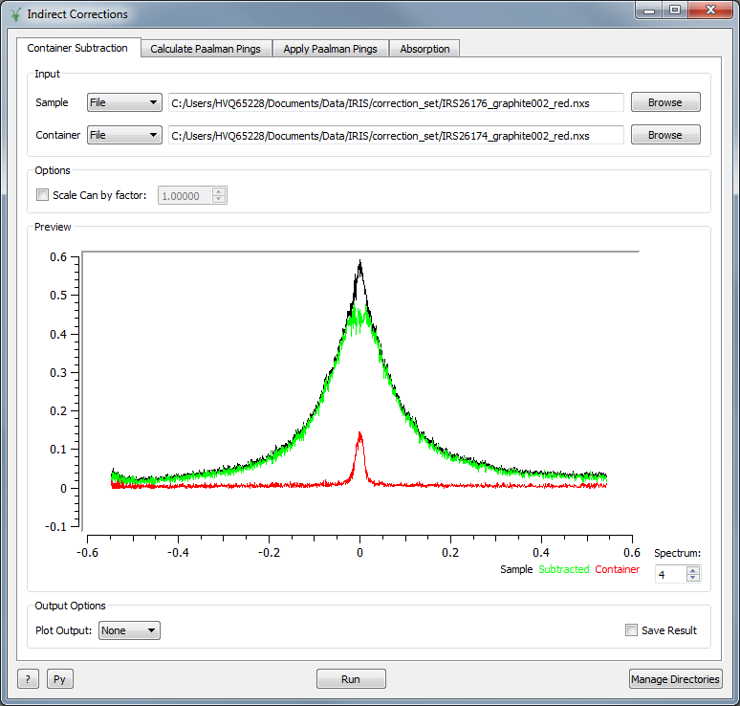
Corrections
New interface
Interfaces > Indirect > Corrections
Container Subtraction
Simple interface that only subtracts the container

